Slide 1
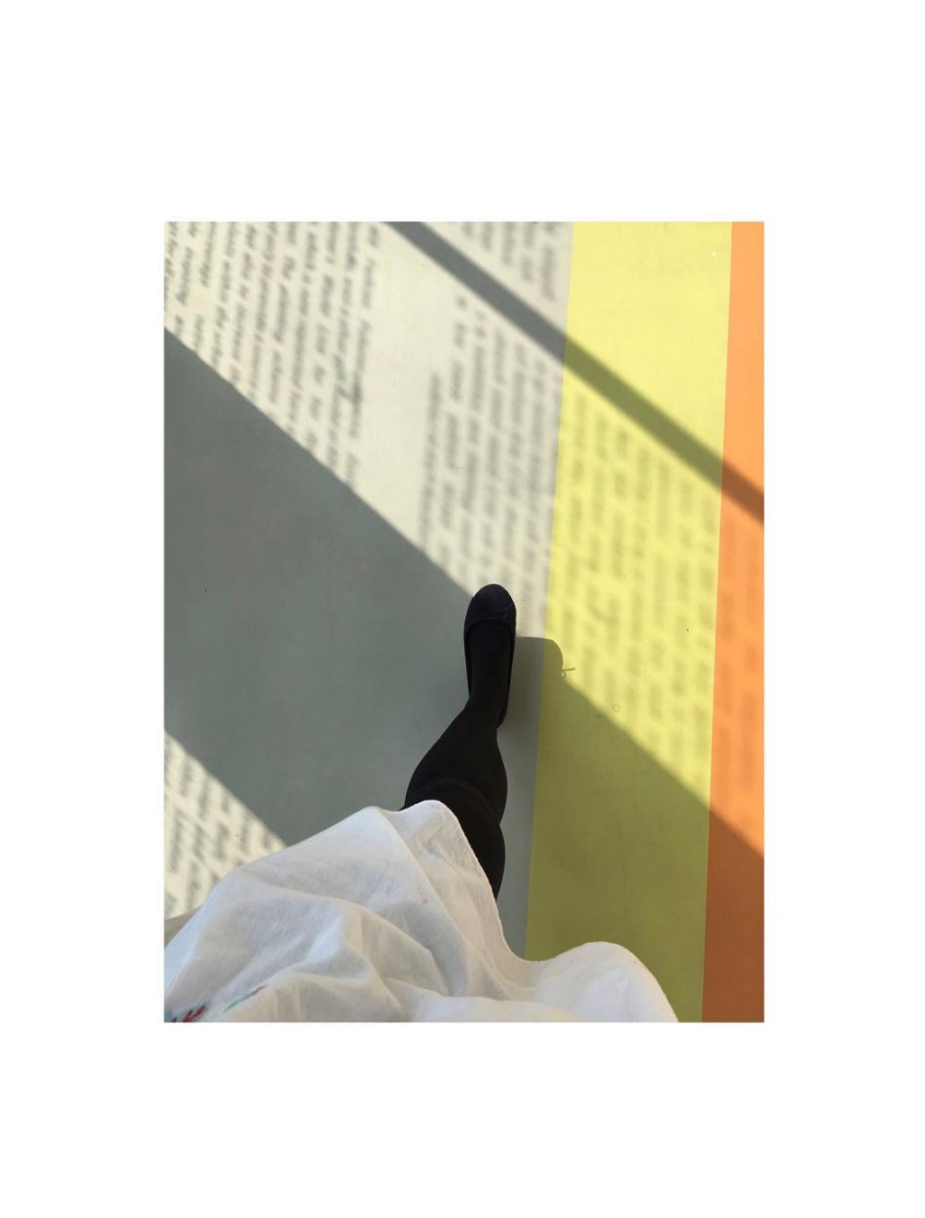
PgCert Academic Practice in Art, Design and Communication.
Action Research Project:
Using creative writing in the form of psychotherapy vignettes, to explore social justice themes of intersectionality and inclusivity in student counselling at UAL.
University of the Arts London: LCF
Jackie Roberts
Existential Psychotherapist and Counsellor
(UKCP acc).
University of the Arts London
Image: 1

Slide 2
Knowledge “Critically analyse how a social justice issue within your academic practice context impacts student experience”
With a focus on social justice (Tyler, T 2000), I wanted to continue the conversation around inclusivity from the Inclusive Practices unit. I wanted to produce a teaching and learning exercise for my immediate team to discuss intersectionality (Crenshaw, K.1989), and how best to support students presenting with intersectional issues.
I also wanted to have a resource for new counsellors, or colleagues in the wider team of Counselling, Health, and Chaplaincy (CHAC), to demonstrate some of the intersectional issues facing students coming for counselling.
Image:2 between cultures

Slide 3
Knowledge Attainment and participation statistics
“there are persisting inequalities in both participation and attainment based on gender, social class, and ethnicity.” (Richardson et al. 2020).
“Completion rates are 2.4% lower for B.A.M.E students compared to White students and 4.9% lower for Black students. The gap in receiving first-class or 2:1 degrees between White and B.A.M.E students averages 12.3% but can exceed 20% at some universities.” (UAL publishes ethnic representation index 2023)
Image: 3

Slide 4
Enquiry “Develop a feasible and detailed research design”. Research methods
I started in the ‘planning’ phase of the action research cycle.
It was not immediately obvious where to start, as the role of student counsellor does not have a teaching component with students, per se.
I started to think about what kind of research could enhance the student experience within the teaching environment at UAL
O’Leary’s cycles of research (adapted from Koshy, Heather, & Valsa, 2010)

Slide 5
Research methods
Difficulty in sharing the content of what happens in counselling sessions due to client confidentially.
And yet it is vital to be able to talk about the work to share best practice.
Also, people are genuinely interested in what happens in the counselling room.
I started looking into creative inquiry methods of research and Ethnographic Research methods and came across Vignette Research.
(More about these research methods on my blog)
Image: 4

Slide 6
Research Methods
Psychotherapy and Counselling
Yalom, I.D. (1989). Love’s Executioner and other tales of Psychotherapy. New York: Basic Books
Orbach, S. (2016). In Therapy. How conversations with psychotherapists really work. London: Profile Books ltd.
Rogers, C. (1967). On becoming a person. A therapist’s view of psychotherapy. 60th anniversary edition. London: Robinson.
Grosz, Stephen (2013). The Examined Life: how we lose and find ourselves. New York: Norton. Eaves, W. (2014). The Absent Therapist. London: CB editions
Image: 6

Slide 7
Research question
“Vignette research is an innovative qualitative, narrative and phenomenological research methodology…Vignettes are concise narratives, which capture human experiences in real life settings. They reveal surprising or intriguing facets and intangible moments (Agostini, E et al. 2024).
Image: 7

Slide 8
Process “Design, implement, and review research methods and instruments appropriate to your question”
Act (Implementation)
I wanted to write about my work as a counsellor in the style of Yalom, and Orbach, and specifically what happens within the counselling sessions.
I needed to think of the ethical considerations of the research. With confidentiality being paramount.
I also wanted to bring authentic student voices to the research.
And I wanted to do it in a creative way.
O’Leary’s cycles of research (adapted from Koshy, Heather, & Valsa, 2010)

Slide 9
Process
After getting my ethics form signed off, I sent an information sheet and consent form to five students I had been working with.
Each faced a variety of intersectional issues based on gender, ethnicity, neurodiversity, class, socio-economic background, caring responsibilities, having family members with addictions, and mental health issues. All were struggling academically as a result.
Out of the five, three gave consent, and I named these students, Isobel, Sebastian, and Fleur.
Image: 9

Slide 10
Process
One student, who I have named Joy, did not want to give consent. This was valuable in our work together within the counselling sessions, it is important to have autonomy, and it is okay to say no!
One student didn’t reply at all, I have named her Kehinde, and I feel that this is indicative of the level of overwhelm she was feeling, because of intersecting issues.
Image: 10

Slide 11
Process
Observe: Research/data collection
At this stage of the research cycle, I had consent from three students.
I began writing the vignettes with the intersecting themes as the thread which ran through each one, and the rest was creative writing/semi-fiction, based on an amalgamation of all the students I have worked with over the past 8 years of working as a student counsellor at UAL.
Each vignette was approximately 1000 – 1500 words.
(Vignettes can be found on my blog)
O’Leary’s cycles of research (adapted from Koshy, Heather, & Valsa, 2010)

Slide 12
Fleur
“Fleur applied for counselling as she was feeling low and wanted to talk to someone. She had just started the first year of BA Womenswear at London College of Fashion”
“Fleur was a mature student and at 25, although not at all old, she noticed her age and found that she couldn’t really relate to the 18- and 19-year-olds on her course”
“She had previously had therapy, through the local child and adolescent mental health services (CAMHS) in Brighton”
“She had grown up with her mum, who was quite young when she had Fleur. Fleurs mother and father separated when she was still a baby. Fleurs father moved to Bristol and re-married and she didn’t see him much growing up. Fleurs’ mother suffered from bi-polar disorder, and Fleur often took on the parental role to take care of her and this meant that she grew up faster than she should have done.”
(Full vignette on blog)

Slide 13
Fleur
“The intersectionality of growing up in a single parent household, with a parent with a serious mental health condition, and a low socioeconomic status meant that she always felt that she didn’t belong at university.”
“The Counselling sessions became a brief opportunity of reparenting, with the safety, continuity and consistency of the sessions, and the space to start to heal. She was then able to start to reparent herself and to give to herself all of the nurturing she needed as a child.”
“Her depression started to lift, and she made some friends in the halls of residence and her confidence grew, she carved out a routine for herself of exercise and sleeping well and she focussed on her coursework. The counselling was focussed on staying with her experience, a phenomenological enquiry of where she is now in relation to what had gone before and where she wanted to be. This Existential approach suited Fleur as it gave her the space to explore what this new chapter of her life meant to her.” (Full vignette on blog)

Slide 14
Reflections
Reflect: Critical Reflexivity
O’Leary’s cycles of research (adapted from Koshy, Heather, & Valsa, 2010)

Slide 15
Reflections and what next?
The experience of writing the vignettes was incredibly therapeutic for me.
Creative writing helped me to reflect on my practice and to process my thoughts and feelings.
It also helped me to consolidate the knowledge taken from the PgCert, and the overall experience.
I will propose utilising one of the weekly counselling meetings as a reflective practice to discuss intersectionality, inclusivity, and how best to support our students.
Additionally, I will propose doing the same thing but in the larger clinical meeting with mental health advisers and chaplains as well.
I will also suggest that the vignettes are integrated into the training manual for new counsellors and therapists so they can have an indication of the intersecting issues we are working with within the student population at UAL, keeping the important social justice topic of intersectionality firmly on the agenda, and inclusivity front and centre of the work we do.
Image: 11

Slide 16
References
Barter, Christine & Emma Renold, 1999: “The use of vignettes in qualitative research” in Social Research Update. Vol. 25.
dew, chris (no date) August 13, 2023 15 Great Ethnography Examples., https://helpfulprofessor.com/ethnography-examples/.
Finch, Janet, 1987: “The Vignette Technique in Survey Research” in Sociology. Vol. 21, pp. 105-114.
O’Leary’s cycles of research (adapted from Koshy, Heather, & Valsa, 2010)
Mark Bevir, 2006: “How Narratives explain” in: (ed. Dvora Yanow and Peregrine Schwartz-Shea) Interpretation and Method: Empirical Research Method and the Interpretive Turn, New York: M.E. Sharpe. PP. 281-290.
Maxwell, Joseph A., 2004: “Using Qualitative Methods for Causal Explanation”, pp. 243-264 in: Field Methods, Vol 16, No. 3.

Slide 17
References
7) Richardson, J.T.E., Mittelmeier, J. and Rienties, B. (1970) The role of gender, social class and ethnicity in participation and academic attainment in UK higher education: An update, Open Research Online. Available at: https://oro.open.ac.uk/68282/ (Accessed: 12 January 2024).
8) Satchwell, C. et al. (2020) ‘Stories as findings in collaborative research: Making meaning through fictional writing with disadvantaged young people’, Qualitative Research, 20(6), pp. 874–891. doi:10.1177/1468794120904892.
9) (No date a) The research vignette: Reflexive writing as interpretative ... Available at: https://journals.sagepub.com/doi/10.1177/1077800416658066 (Accessed: 13 January 2024).
10) Tyler, T (2000). “Social Justice: Outcome and Procedure,” International Journal of Psychology, 35(2), 117-125.
11) UAL publishes ethnic representation index 2023 (no date) UAL Staff Careers. Available at: https://jobs.arts.ac.uk/story/ual-publishes-ethnic-representation-index-2023/ (Accessed: 13 January 2024).
(Full reference list for ARP on blog)

Slide 18
References
Image references
Roberts, J. ( 2023) LCF – Mare Steet: London.
Roberts, J. ( 2023) A bridge between cultures: Musée du quai Branly - Jacques Chirac, - Paris.
Roberts, J. (2016) Steps at the Wallace Collection, Marylebone. London.
Roberts, J. (2017) Private Practice : Marylebone, London.
Roberts, J. (2016) Flower in Vase. Ongea Therapy : London.
Roberts, J. (2017) Therapy Chair : Hackney, London.
Roberts, J. (2021) Photograph of artwork by Jennifer Packer, taken at the Serpentine Gallery : London.
Roberts, J. (2017) Private Practice, Duke Street, Marylebone : London.
Roberts, J. (2018) Winter sun, Shoreditch : London.
Roberts, J. (2016) Flowers in a vase. Ongea Therapy : London.
(All images’ authors own: Instagram: Therapy_East).

